Slide 1
3D Graphics

Slide 2

Module Learning Objectives
Game engine architecture, subsystems, design patterns and scripting
Advanced real-time 3D graphics techniques for game development
3D graphic effects through shader programming
Advanced real-time interactive 3D games individually or in a team setting

Slide 3

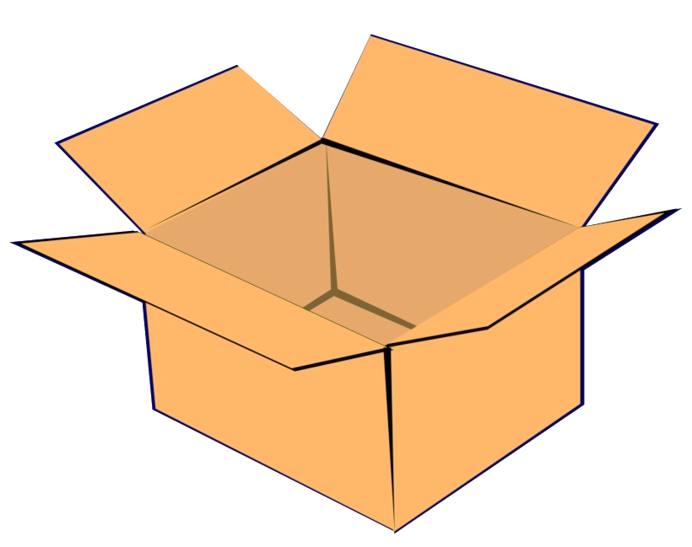


Module Content
Proficiently and creatively use Unity game engine
Game engine architecture
3D graphics rendering pipeline
3D graphics shading and lighting techniques
Shaders
Phong model

Slide 4

Learning Approach
Independent reading and project work
Online tutorials
Lecture quizzes
Teamwork/collaboration
Project progress every week
Version control
Self-evaluation
Reports

Slide 5

Teamwork
Project and some labs
Github
Microsoft 365, Google Docs

Slide 6

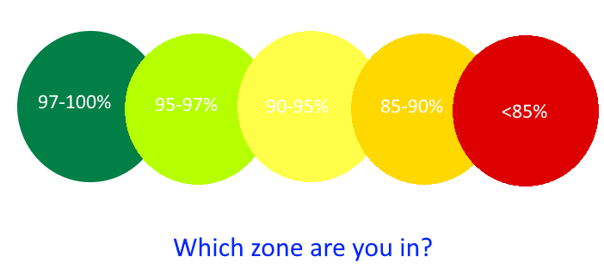
Attendance
Class attendance is critical

Slide 7

Exams and Assessments
Continuous Assessment 30%
2 exams (1 in Wk7, 1 in Wk11)
Project 40%
Practical 30%
Lab collaboration
Completion of lab tasks
Demo
No End of Module Formal Examination

Slide 8


Requirements

Slide 9
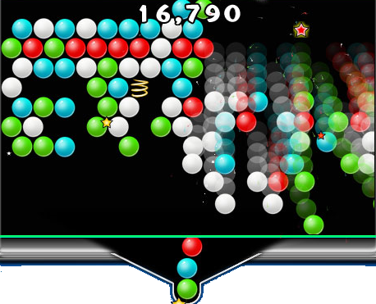
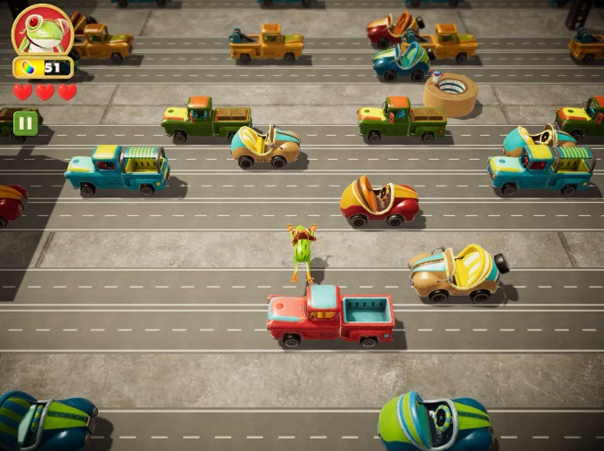

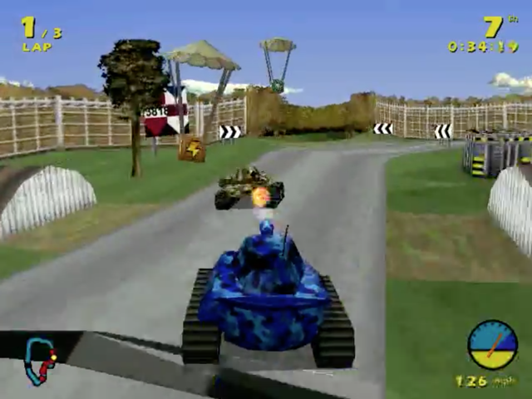

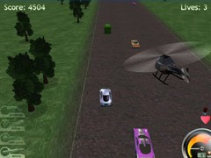
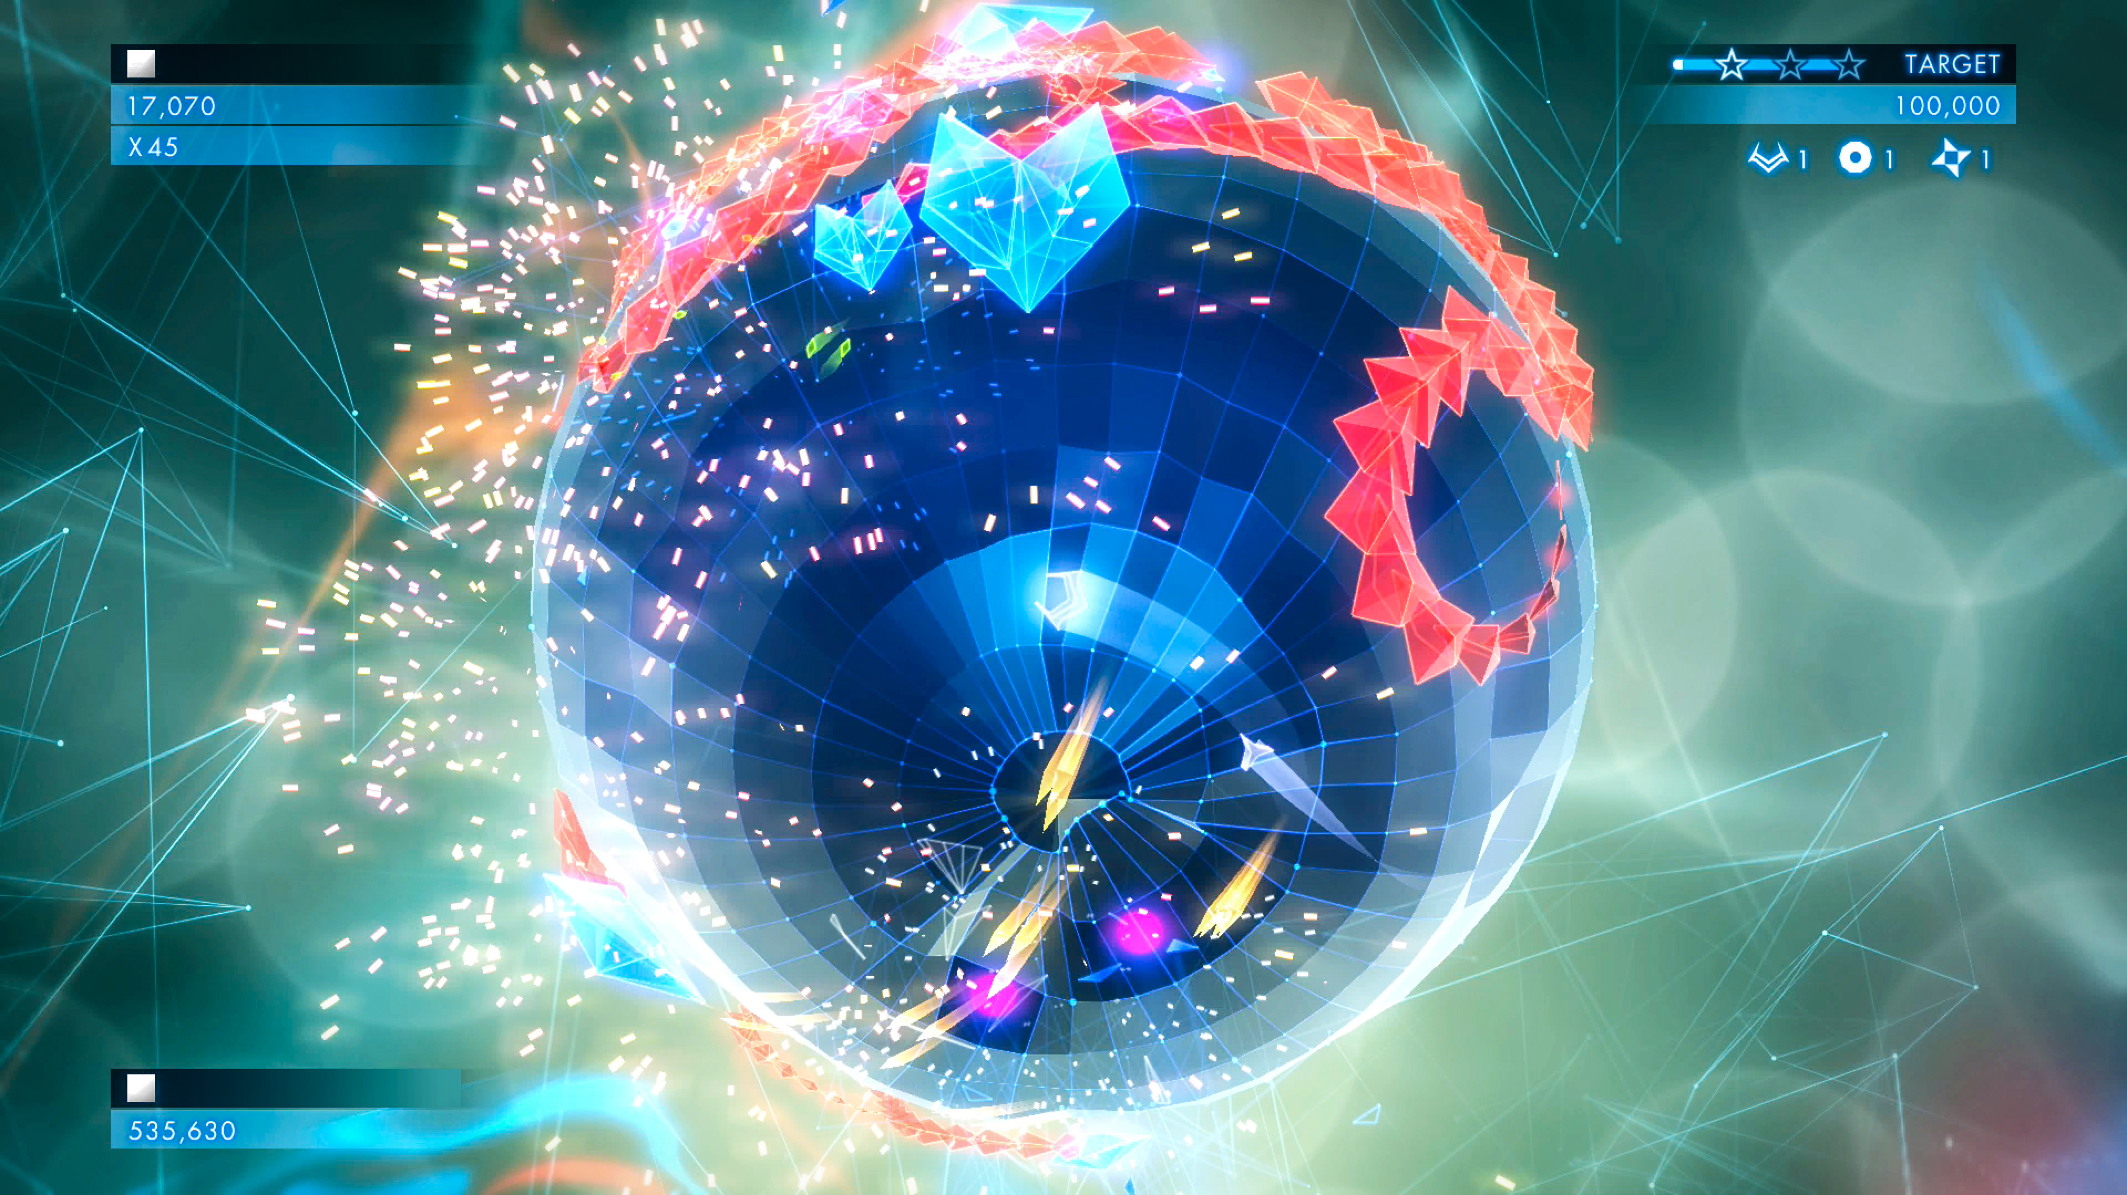
Past Projects
3D Super Pop & Drop
Frogger
Supercollapse
Tank Racing
Tetris
3D Highway Pursuit

Slide 10
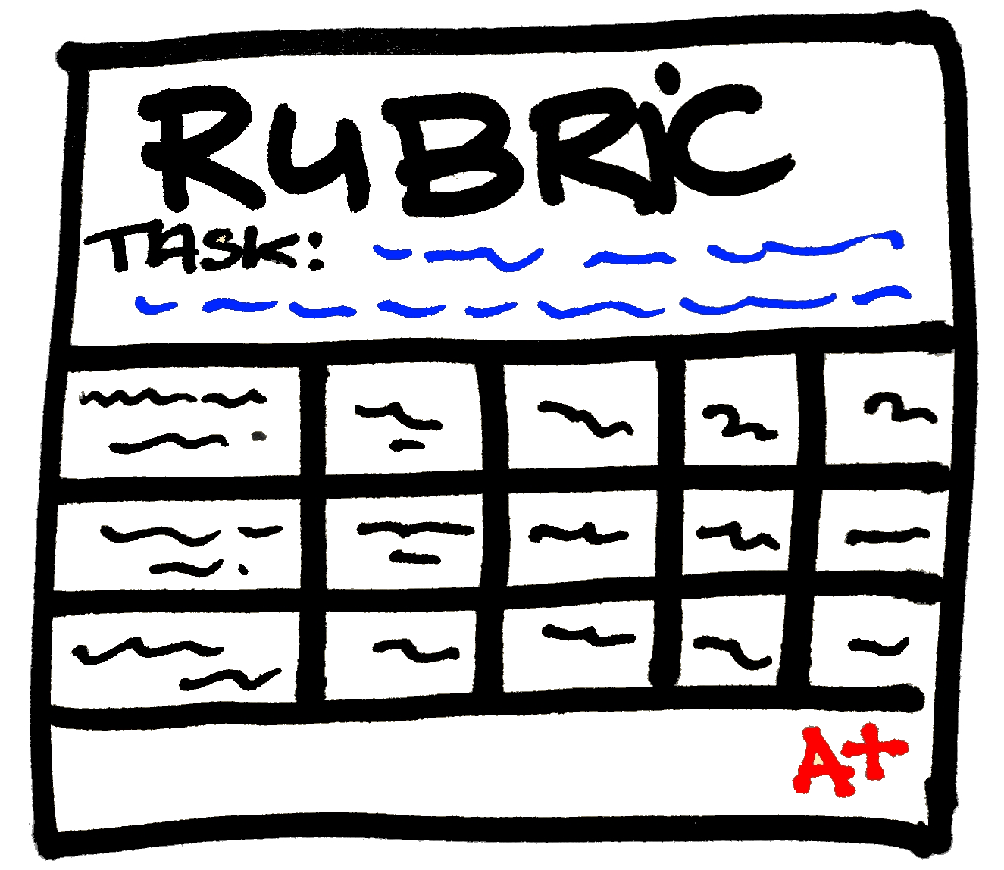


Version Control
Clean organised efficient directory structure
Commit often to share with your team
Each logical unit/subfeature
Don’t commit a half-done feature
Test before you commit
Good descriptive commit messages
Motivation for the change, what is new
Don't commit autogenerated files

Slide 11



Version Control (cont)
Agree workflow
Coordinate with team to avoid conflicts
Avoid editing the same file others may be working on
Do not “unintentionally” overwrite others’ code
Use branches
Pull requests
Use UnityYAMLMerge (smart merge) or prefabs
to merge scenes
Backup working versions
Somewhere else

Slide 12

Your Unity Project
Organised project and hierarchy
Assets, Packages, ProjectSettings
Ignore (.gitignore) autogenerated files and directories
e.g. library, temp, *.csproj, …

Slide 13
Your Unity Project (cont)
Document and format code
Author/date
Purpose of class
Purpose of unobvious statement or function
Test frequently
Build executable for testing and demo
Report
Submit on Bb

Slide 14
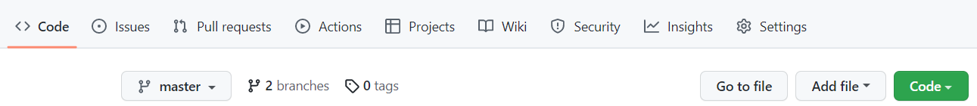
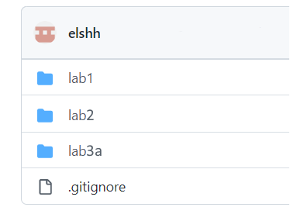
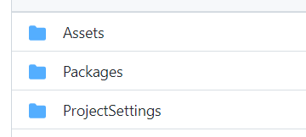
GitHub Directory Structure

Slide 15
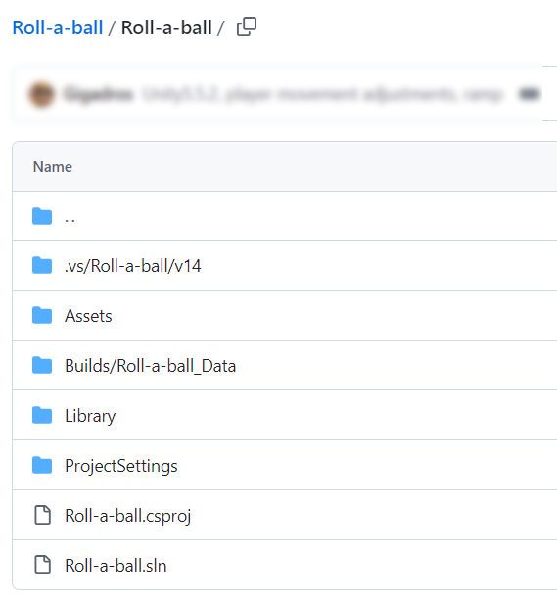




Slide 16
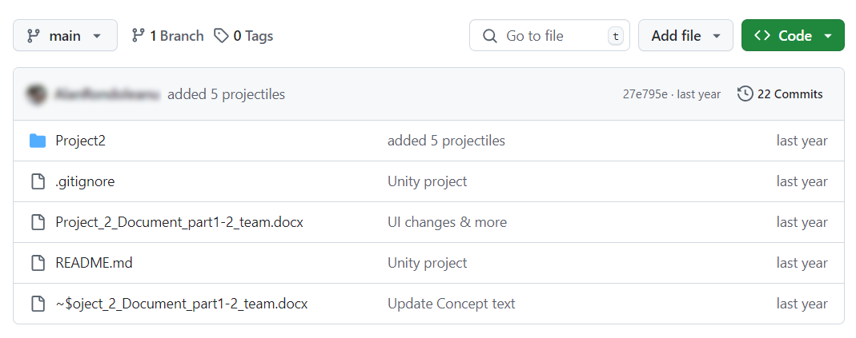

Slide 17
.gitignore
#Unity generated
[Ll]ab*/[Ll]ibrary/
[Ll]ab*/[Tt]emp/
[Ll]ab*/[Oo]bj/
[Ll]ab*/[Ll]ogs/
[Ll]ab*/Assets/AssetStoreTools*
#Visual Studio generated
…
Use suggested .gitignore file (see Blackboard)
Edit as necessary to ignore unrequired files
If .gitignore is working you should only see in Git client the changed files you want.
#OS generated
…

Slide 18
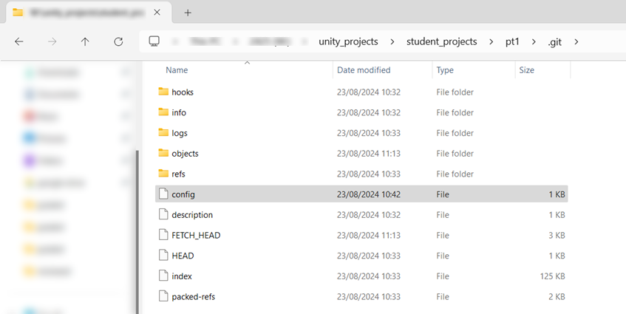
https://docs.unity3d.com/Manual/SmartMerge.html
C:\Program Files\Unity\Editor\Data\Tools\UnityYAMLMerge.exe
[merge]
tool = unityyamlmerge
[mergetool "unityyamlmerge"]
trustExitCode = false
cmd = '<path to UnityYAMLMerge>' merge -p "$BASE" "$REMOTE" "$LOCAL" "$MERGED"

Slide 19
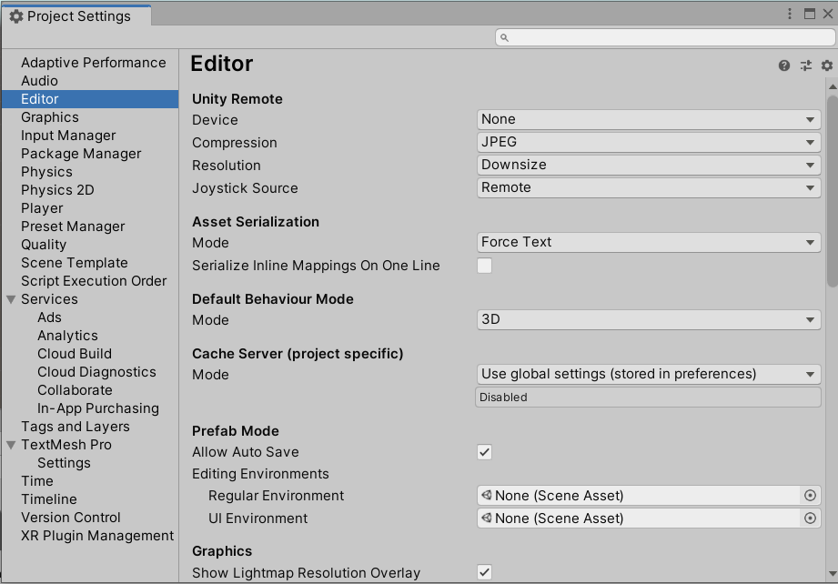
Version Control
Edit->Project Settings->Editor

Slide 20
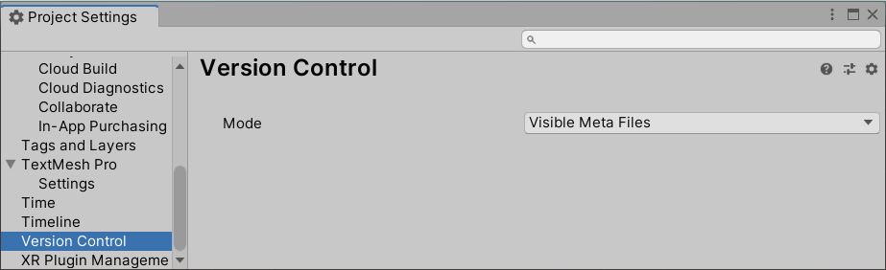
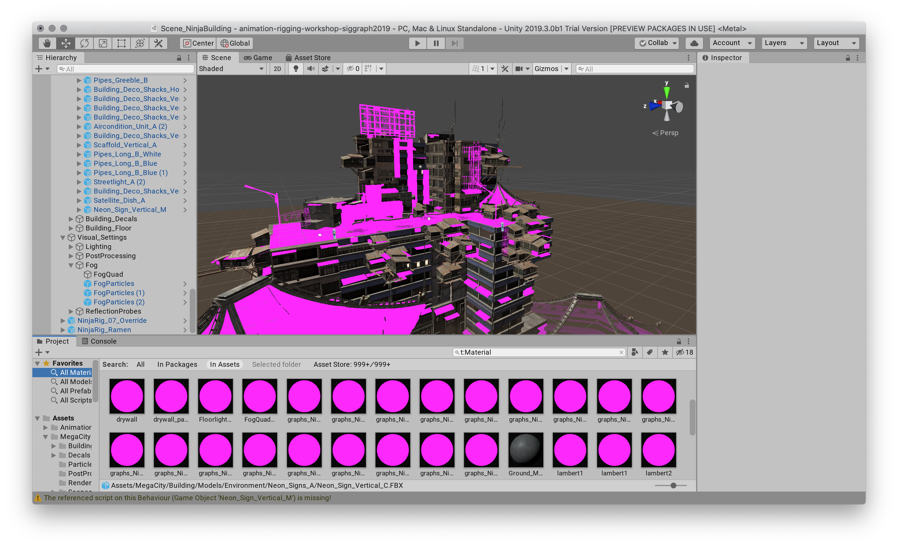

Slide 21
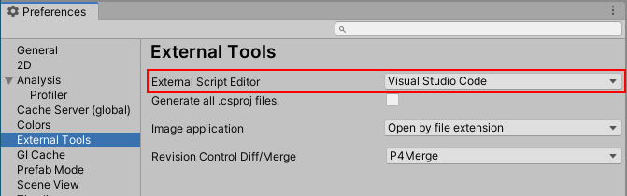
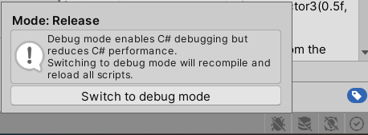

Editing and Debugging Unity Scripts
Visual Studio
Install Unity extension
Visual Studio Code
Install Unity extension
Jetbrains Rider
Support break points, single stepping and variable inspection

Slide 22
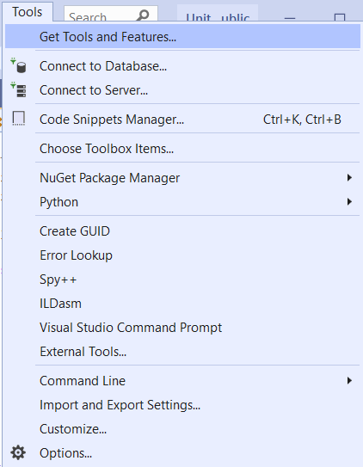
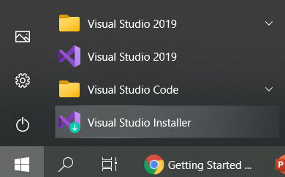
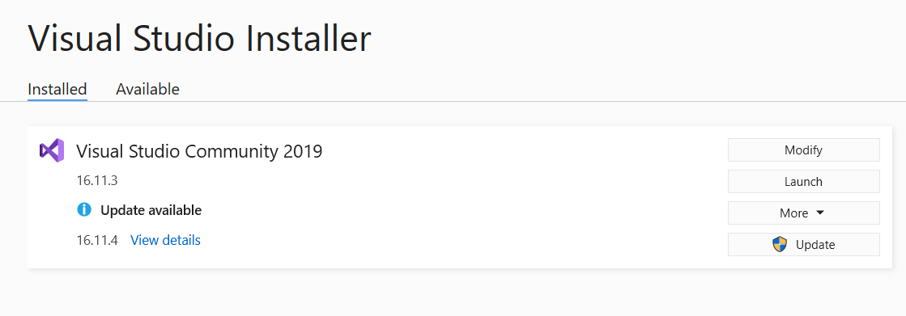
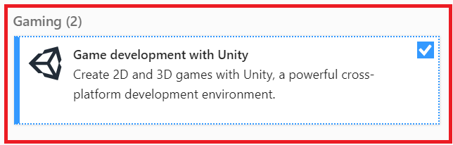
Visual Studio Tools for Unity

Slide 23
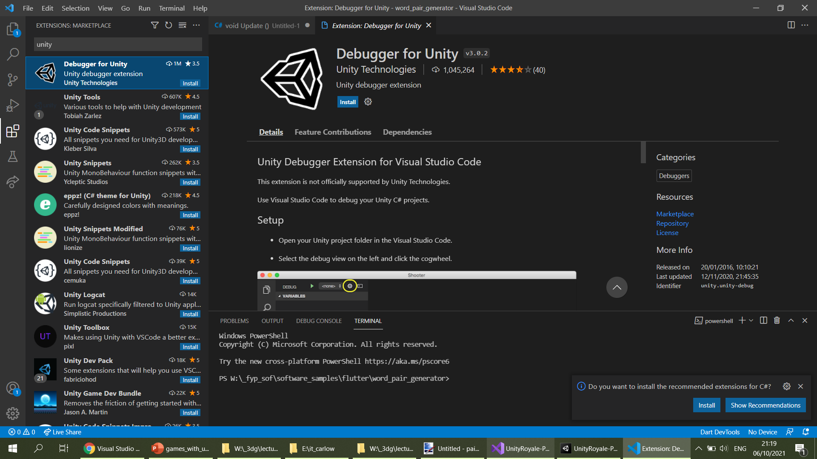

Slide 24
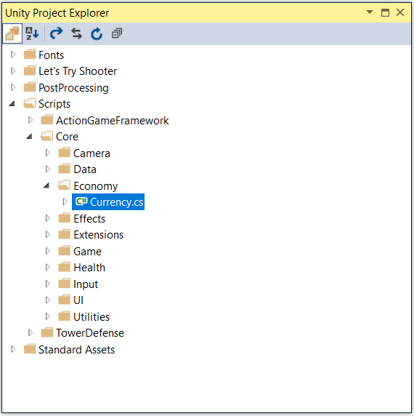
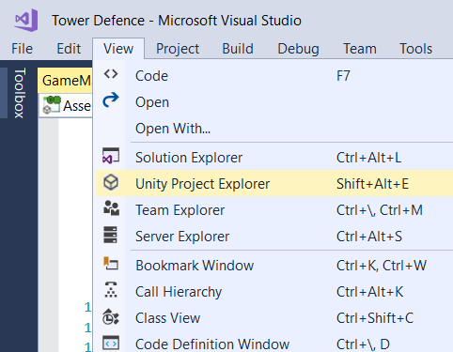
Visual Studio Tools for Unity

Slide 25
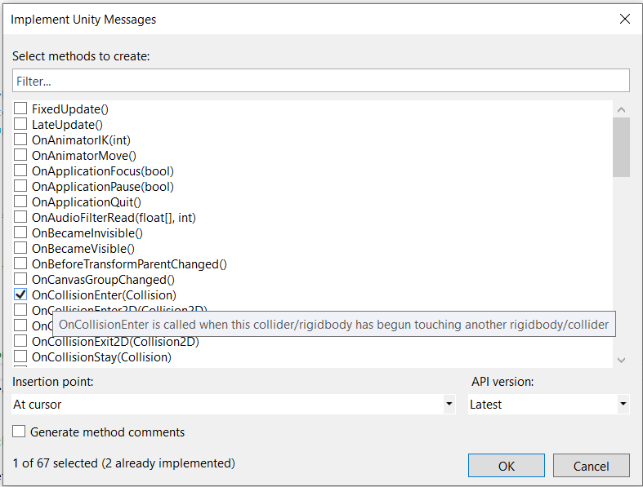
Visual Studio Tools for Unity (cont)
Ctrl+Shift+M

Slide 26



Reading
Jason Gregory 2018, Game Engine Architecture, 3rd Ed., A K Peters/CRC Press, ISBN 9781138035454
JungHyun Han, 2011, 3D Graphics for Game Programming, Chapman and Hall/CRC, ISBN 9781439827376
https://docs.unity3d.com
Online resources e.g. Stackoverflow

